Slide 1
Design Pattern
4210161013 Muhammad Aditya Devara
4210161027 Achmad Robith Fuadi

Slide 2
Creational Design Pattern

Slide 3
Creational Design Pattern
Dealing with object creation mechanism
Controlling object creation
Create object in a manner suitable to the situation

Slide 4
Creational Design Pattern
Abstract Factory
Builder
Factory Method
Prototype
Singleton

Slide 5
Factory Method
Provides an interface for creating objects in superclass, but let subclasses decide which class to instantiate.
Allow subclasses to alter the type of objects that will be created
Virtual constructor

Slide 6
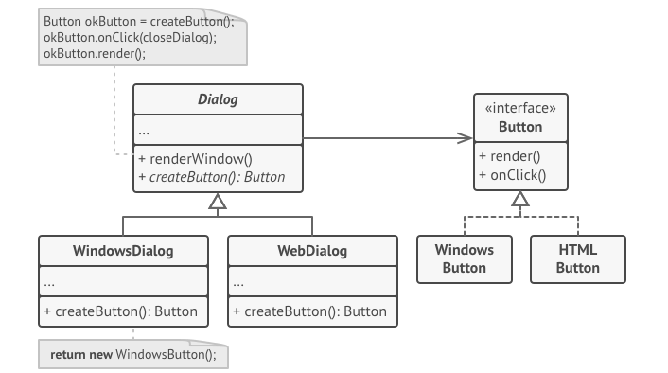
Factory Method

Slide 7
Builder
Separate the construction of a complex object from its representation so that the same construction process can create different representations
Produce different types and representations of an object using the same building process
Constructing complex objects step by step

Slide 8
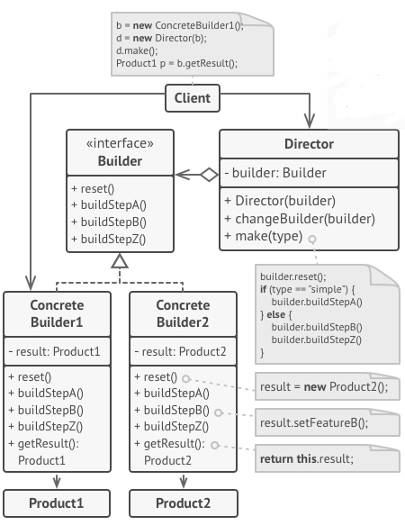
Builder

Slide 9
Behavioural Design Pattern
Identify common communication patterns between objects.
Increase flexibility in carrying out this communication
Responsible for the efficient and safe distribution of behaviours

Slide 10
Behavioural Design Pattern
Chain of responsibility
Command
Iterator
Mediator
Memento
Observer
State
Strategy
Template method
Visitor

Slide 11
Command
Encapsulate a request as an object, letting you parametrize clients with different requests, queue or log requests, and support undoable operations.
Object-oriented callback

Slide 12
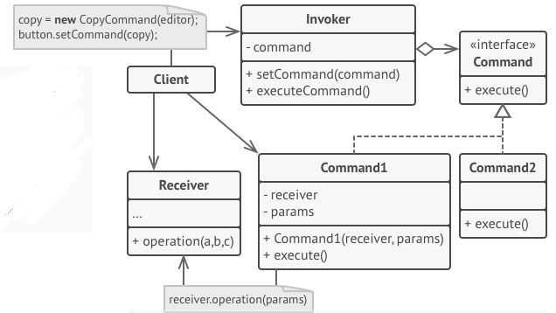
Command

Slide 13
Observer
Define a one-to-many dependency between objects
When one object changes state, all its dependents are notified and updated automatically.
Encapsulate the core components in a Subject abstraction, and the variable components in an Observer hierarchy.
The "View" part of Model-View-Controller

Slide 14
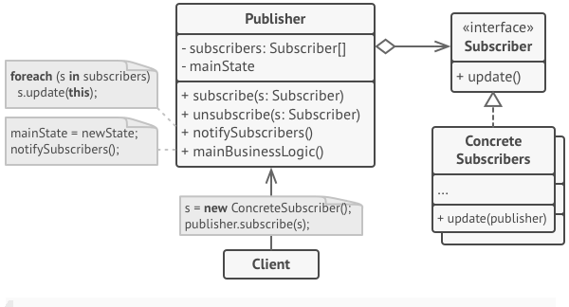
Observer

Slide 15
Structural Design Pattern
Ease the design by identifying a simple way to realize relationships between entities
Building simple and efficient class hierarchies and relations between different classes

Slide 16
Structural Design Pattern
Adapter
Bridge
Composite
Decorator
Facade
Flyweight
Proxy

Slide 17
Flyweight
Use sharing to support large numbers of fine-grained objects efficiently
Fit more objects into the available amount of RAM by sharing common parts of object state among multiple objects

Slide 18
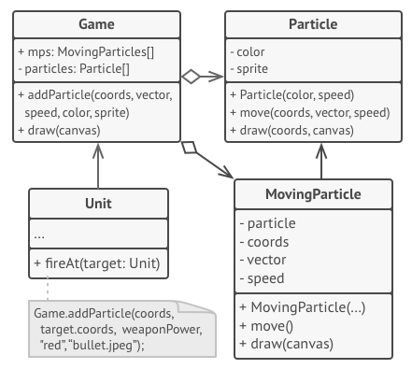
Flyweight

